Slide 1
Computer Organization and Assembly Language
By Abdual Qaddous

Slide 2
About the Course
Course Code: CSC-542
Course Title: Computer Organization & Assembly Language
Instructor: Abdual Qaddous
Email Address: Abdual.qaddous@ajku.edu.pk
Term (Semester): Spring, 2025
Duration: 15/16 Weeks

Slide 3
Course Objective
1
The main objective of this course is to introduce the organization of computer systems and usage of assembly language for optimization and control.
Emphasis should be given to expose the low-level logic employed for problem solving while using assembly language as a tool.
At the end of the course the students should be capable of writing moderately complex assembly language subroutines and interfacing them to any high level language.

Slide 4
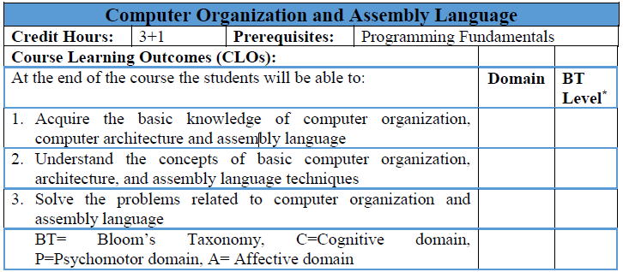

Slide 5
Course Outline (1/3)
1.Introduction to computer systems:
Information is bits + context, programs are translated by other programs into different forms,
It pays to understand how compilation systems work,
Processors read and interpret instructions stored in memory,
Caches matter,
Storage devices form a hierarchy,
The operating system manages the hardware,
Systems communicate with other systems using networks;

Slide 6
Course Outline (2/3)
2.Representing and manipulating information:
Information storage,
Integer representations,
Integer arithmetic, floating point;.
3. Machine-level representation of programs:
A historical perspective, program encodings,
data formats, accessing information,
arithmetic and logical operations,
control, procedures, array allocation and access,
heterogeneous data structures,

Slide 7
Course Outline (3/3)
4. Putting it together:
Understanding pointers,
Life in the real world:
Using the gdb debugger,
Out-of-bounds memory references and buffer overflow,
X86-64: extending ia32 to 64 bits,
Machine-level representations of floating-point programs;
5.Processor architecture:
The Y86 instruction set architecture,
Logic design and the Hardware Control Language (HCL),
Sequential Y86 implementations,
General principles of pipelining,
Pipelined Y86 implementations

Slide 8
Course Material
Material Will be Available through Slides and Notes
Reference Books:
Text/Reference Books:
1. Computer Systems: A Programmer's Perspective, 3/E (CS:APP3e), Randal E. Bryant and David R.O' Hallaron, Carnegie Mellon University
2. Robert Britton, MIPS Assembly Language Programming, Latest Edition,
3. Computer System Architecture, M. Morris Mano, Latest Edition,
4. Assembly Language Programming for Intel- Computer, Latest Edition

Slide 9
Assessment
Assessment | Marks
Quizzes [Q] (Multiple) [Announced & Surprised] | 05
Assignments [A] (Multiple) [Presentations & Class Tasks] | 10
Sessional [S] | 20
Terminal [T] [Must Secure 40% in Exam] | 40
Lab [P] [Lab Tasks, DIY Tasks] | 25
Total Marks | 100
Must Secure 50% Marks in Theory [Q + A + S + T]
Must Secure 40% Marks in Terminal [T] Examination
Must Secure 50% Marks in Practical [P]

Slide 10
Important Issues
Attendance policy and late comers
Assignment's policy (All assignments should be typed)
Title page includes:
Name, Registration and roll number
Course code and title
Assignment name and number
Semester and Session
Submission date
Heading Font Size: 12, Bold and may be underlined
Font Style: Times New Roman, Arial or Book Antiqua; Text Font Size: 12
Page numbers
Table of contents for large assignments (applicable for more than 5 pages)
Single spacing and Justified text
No color except black and blue
References of the material used (NO COPIED MATERIAL WILL BE ACCEPTED)

Slide 11
Introduction to Computer Systems
A computer system consists of hardware and systems software that work together to run application programs.
Specific implementations of systems change over time, but the underlying concepts do not.
All computer systems have similar hardware and software components that perform similar functions.

Slide 12
Life Time
#include <stdio.h>
int main()
{
printf("hello, world\n");
return 0;
}
How this program translate to machine language?

Slide 13
ASCII Presentation
# | i | n | c | l | u | d | e | sp | <
35 | 105 | 110 | 99 | 108 | 117 | 100 | 101 | 32 | 60
s | t | d | i | o | . | h | > | \n | i
115 | 116 | 100 | 105 | 111 | 46 | 104 | 62 | 10 | 105
n | t | sp | m | a | i | n | ( | ) | \n
110 | 116 | 32 | 109 | 97 | 105 | 110 | 40 | 41 | 10
{ | \n | p | r | i | n | t | f | ( | “
123 | 10 | 112 | 114 | 105 | 110 | 116 | 102 | 40 | 34
h | e | l | l | o | , | sp | w | o | r
104 | 101 | 108 | 108 | 111 | 44 | 32 | 119 | 111 | 114
l | d | \ | n | “ | ) | ; | \n | r | e
108 | 100 | 92 | 110 | 34 | 41 | 59 | 10 | 114 | 114
t | u | r | n | sp | 0 | ; | \n | }
116 | 117 | 114 | 110 | 32 | 48 | 59 | 10 | 125

Slide 14
Information Is Bits + Context
Source code or source file created by programmer in editor.
The source program is a sequence of bits, each with a value of 0 or 1, organized in 8-bit chunks called bytes.
Each byte represents some text character in the program.
Most computer systems represent text characters using the ASCII standard that represents each character with a unique byte-size integer value.
The program is stored in a file as a sequence of bytes.
Each byte has an integer value that corresponds to some character.
Files such as this program that consist exclusively of ASCII characters are known as text files.

Slide 15
Cont..
All other files are known as binary files
All information in a system including disk files, programs stored in memory, user data stored in memory, and data transferred across a network is represented as a bunch of bits.
The only thing that distinguishes different data objects is the context in which we view them.
For example, in different contexts, the same sequence of bytes might represent an integer, floating-point number, character string, or machine instruction.
As programmers, we need to understand machine representations of numbers because they are not the same as integers and real numbers.

Slide 16
Programs Are Translated by Other Programs into Different Forms
The program begins life as a high-level C program because it can be read and understood by human beings in that form.
However, in order to run program on the system, the individual C statements must be translated by other programs into a sequence of low-level machine-language instructions.
These instructions are then packaged in a form called an executable object program and stored as a binary disk file.
Object programs are also referred to as executable object files.

Slide 17
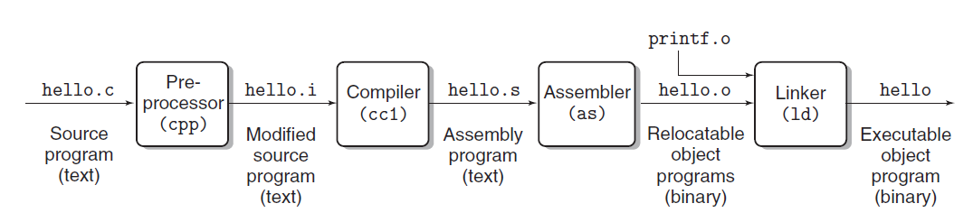
Compilation System

Slide 18

Translation of Code
The translation is performed in the sequence of four phases
The programs that perform the four phases (preprocessor, compiler, assembler, and linker) are known collectively as the compilation system.
1. Preprocessing phase: The preprocessor (cpp) modifies the original C program according to directives that begin with the ‘#’ character. For example, the #include <stdio.h> command in line 1 of hello.c tells the preprocessor to read the contents of the system header file stdio.h and insert it directly into the program text. The result is another C program, typically with the .i suffix.
2. Compilation phase: The compiler (cc1) translates the text file hello.i into the text file hello.s, which contains an assembly-language program. This program includes the following definition of function main:

Slide 19
Cont..
#include <stdio.h>
int main()
{
printf("hello, world\n");
return 0;
}
main:
subq $8, %rsp
movl $.LC0, %edi
call puts
movl $0, %eax
addq $8, %rsp
ret
Each line describes one low-level machine language instruction in a textual form.
Assembly language is useful because it provides a common output language for different compilers for different high-level languages.
For example, C compilers and Fortran compilers both generate output files in the same assembly language.

Slide 20
Cont..
3.Assembly phase:
Next, the assembler (as) translates hello.s into machine language instructions, packages them in a form known as a relocatable object program, and stores the result in the object file hello.o.
This file is a binary file containing 17 bytes to encode the instructions for function main.
If we were to view hello.o with a text editor, it would appear to be nonsense.
4.Linking phase:
Notice that our hello program calls the printf function, which is part of the standard C library provided by every C compiler.
The printf function resides in a separate precompiled object file called printf.o, which must somehow be merged with our hello.o program.
The linker (ld) handles this merging. The result is the hello file, which is an executable object file (or simply executable) that is ready to be loaded into memory and executed by the system.

Slide 21
It Pays to Understand How Compilation Systems Work
Optimizing program performance.
Modern compilers are sophisticated tools that usually produce good code.
As programmers, we do not need to know the inner workings of the compiler in order to write efficient code.
However, in order to make good coding decisions in our C programs, we do need a basic understanding of machine-level code and how the compiler translates different C statements into machine code.
For example
is a switch statement always more efficient than a sequence of if-else statements?
How much overhead is incurred by a function call?
Is a while loop more efficient than a for loop?
Are pointer references more efficient than array indexes?
Why does our loop run so much faster if we sum into a local variable instead of an argument that is passed by reference?

Slide 22
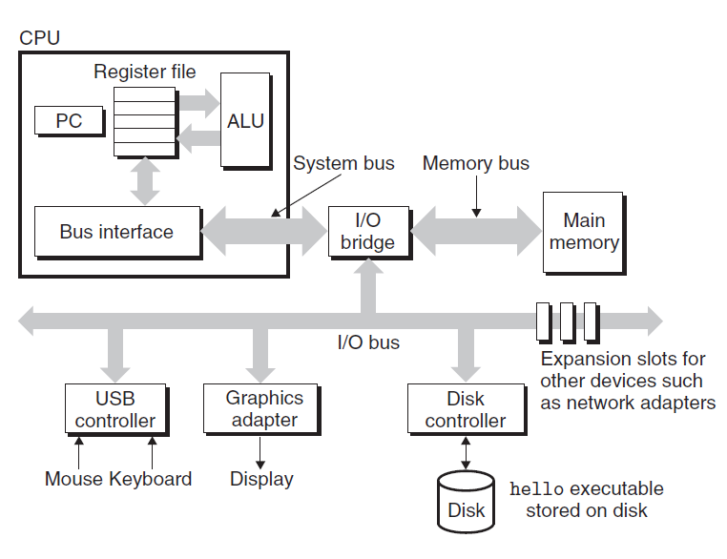
Processors Read and Interpret Instructions Stored in Memory
Hardware organization
of a typical system. CPU:
central processing unit,
ALU: arithmetic/logic unit,
PC: program counter, USB:
Universal Serial Bus.

Slide 23
Buses
Running throughout the system is a collection of electrical conduits called buses that carry bytes of information back and forth between the components.
Buses are typically designed to transfer fixed-size chunks of bytes known as words.
The number of bytes in a word (the word size) is a fundamental system parameter that varies across systems. Most machines today have word sizes of either 4 bytes (32 bits) or 8 bytes (64 bits).
In this book, we do not assume any fixed definition of word size. Instead, we will specify what we mean by a “word” in any context that requires this to be defined.

Slide 24
I/O Devices
Input/output (I/O) devices are the system’s connection to the external world.
Our example system has four I/O devices: a keyboard and mouse for user input, a display for user output, and a disk drive (or simply disk) for long-term storage of data and programs.
Initially, the executable hello program resides on the disk. Each I/O device is connected to the I/O bus by either a controller or an adapter.
The distinction between the two is mainly one of packaging.
Controllers are chip sets in the device itself or on the system’s main printed circuit board (often called the motherboard).
An adapter is a card that plugs into a slot on the motherboard. Regardless, the purpose of each is to transfer information back and forth between the I/O bus and an I/O device.

Slide 25
Main Memory
The main memory is a temporary storage device that holds both a program and the data it manipulates while the processor is executing the program.
Physically, main memory consists of a collection of dynamic random access memory(DRAM) chips.
Logically, memory is organized as a linear array of bytes, each with its own unique address (array index) starting at zero.
In general, each of the machine instructions that constitute a program can consist of a variable number of bytes.
The sizes of data items that correspond to C program variables vary according to type.
For example, on an x86-64 machine running Linux, data of type short require 2 bytes, types int and float 4 bytes, and types long and double 8 bytes.

Slide 26

Processor
The central processing unit (CPU), or simply processor, is the engine that interprets (or executes) instructions stored in main memory.
At its core is a word-size storage device (or register) called the program counter (PC).
At any point in time, the PC points at (contains the address of) some machine-language instruction in main memory.
From the time that power is applied to the system until the time that the power is shut off, a processor repeatedly executes the instruction pointed at by the program counter and updates the program counter to point to the next instruction.
A processor appears to operate according to a very simple instruction execution model, defined by its instruction set architecture.

Slide 27
Cont…
In this model, instructions execute in strict sequence, and executing a single instruction involves performing a series of steps.
The processor reads the instruction from memory pointed at by the program counter (PC), interprets the bits in the instruction, performs some simple operation dictated by the instruction, and then updates the PC to point to the next instruction
There are only a few of these simple operations, and they revolve around main memory, the register file, and the arithmetic/logic unit (ALU).
The register file is a small storage device that consists of a collection of word-size registers, each with its own unique name.
The ALU computes new data and address values. Here are some examples of the simple operations that the CPU might carry out at the request of an instruction:

Slide 28
Cont..
Load: Copy a byte or a word from main memory into a register, overwriting the previous contents of the register.
Store: Copy a byte or a word from a register to a location in main memory, overwriting the previous contents of that location.
Operate: Copy the contents of two registers to the ALU, perform an arithmetic operation on the two words, and store the result in a register, overwriting the previous contents of that register.
Jump: Extract a word from the instruction itself and copy that word into the
program counter (PC), overwriting the previous value of the PC.

Slide 29
Cont..
We say that a processor appears to be a simple implementation of its instruction set architecture, but in fact modern processors use far more complex mechanisms to speed up program execution.
Thus, we can distinguish the processor’s instruction set architecture, describing the effect of each machine-code instruction, from its microarchitecture, describing how the processor is actually implemented.

Slide 30

Running the hello Program
Initially, the shell program is executing its instructions, waiting for us to type a command.
As we type the characters ./hello at the keyboard, the shell program reads each one into a register and then stores it in memory
When we hit the enter key on the keyboard, the shell knows that we have finished typing the command.
The shell then loads the executable hello file by executing a sequence of instructions that copies the code and data in the hello object file from disk to main memory.

Slide 31
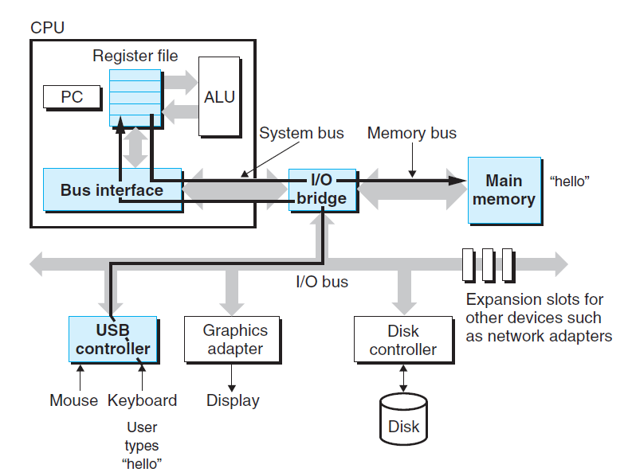
Reading the hello command from the keyboard.

Slide 32
Cont…
The data includes the string of characters hello, world\n that will eventually be printed out.
Using a technique known as direct memory access (DMA) the data travel directly from disk to main memory, without passing through the processor.
Once the code and data in the hello object file are loaded into memory, the processor begins executing the machine-language instructions in the hello program’s main routine.
These instructions copy the bytes in the hello, world\n string from memory to the register file, and from there to the display device, where they are displayed on the screen.

Slide 33
Caches Matter
An important lesson from this simple example is that a system spends a lot of time moving information from one place to another.
The machine instructions in the hello program are originally stored on disk. When the program is loaded, they are copied to main memory.
As the processor runs the program, instructions are copied from main memory into the processor.
Similarly, the data string hello,world\n, originally on disk, is copied to main memory and then copied from main memory to the display device.
From a programmer’s perspective, much of this copying is overhead that slows down the “real work” of the program.
Thus, a major goal for system designers is to make these copy operations run as fast as possible. Because of physical laws, larger storage devices are slower than smaller storage devices. And faster devices are more expensive to build than their slower

Slide 34
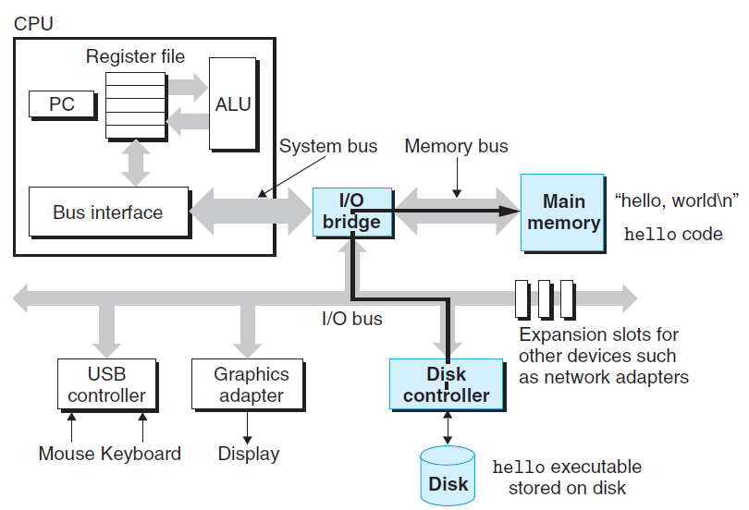
Loading the executable from disk into main memory.

Slide 35
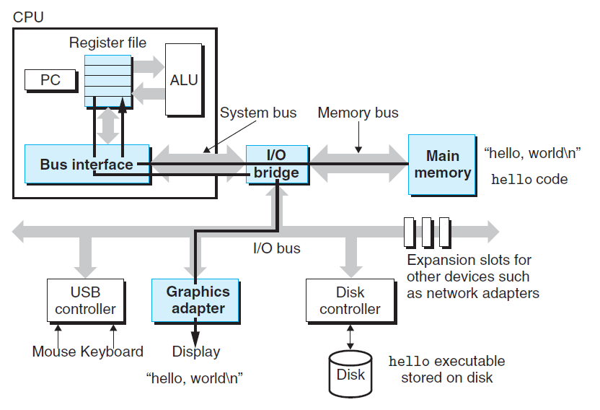
Writing the output string from memory to the display.

